Slide 1
HNDIT1104: Data Representation and Organization
Number systems & Conversion
Part 2
Lesson 3

Slide 2
Learning Objectives
At the end of the Lesson students should be able to
  Convert Decimal fraction to Binary
  Convert Decimal fraction to Octal
  Convert Decimal fraction to Hexadecimal

Slide 3
Fractions
Number point or radix point
  Decimal point in base 10 (Ex: 0.24)
  Binary point in base 2 (Ex: 0.1011)
No exact relationship between fractional numbers in different number bases
  Exact conversion may be impossible

Slide 4
Converting Fractional decimal number to Binary, Octal and Hexadecimal
Technique
- Multiply the decimal fraction by the base you want to convert that number
- Keep the integer in the product as it is and multiply the new fraction in the product. Continue the process and read the integers in the products from top to bottom.

Slide 5
0.81₁₀ → binary???
Conversion of Fractional Decimals to Binary
0.110011₂
0.81₁₀ => 0.81 x 2 = 1.62
0.62 x 2 = 1.24
0.24 x 2 = 0.48 0.48 x 2 = 0.96
0.96 x 2 = 1.92
0.92 x 2 = 1.84
= 0.110011₂ (approximately)

Slide 6
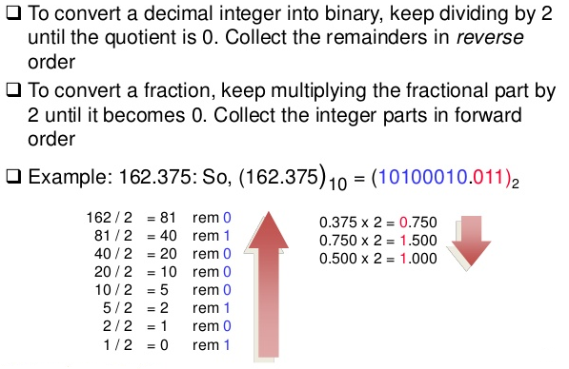
Conversion of Fractional Decimals to Binary

Slide 7
Conversion of Fractional Decimals to Octal
Pair Work: Group, workout and Present
Convert Following Decimals to Octal
Ex1: 0.25
Ex2: 0.34
Ex3: 0.44

Slide 8
Conversion of Fractional Decimal to Hexadecimal
Pair Work: Group, workout and Present
Convert Following Decimals to Hexadecimal
Ex1: 0.25
Ex2: 0.34
Ex3: 0.44

Slide 9
More Exercises
Convert following numbers to binary, Octal and Hexadecimal
1. 12.75
128.0625
256.125
512.5
1024.25

